Slide 1



Disease Blocks

Slide 2
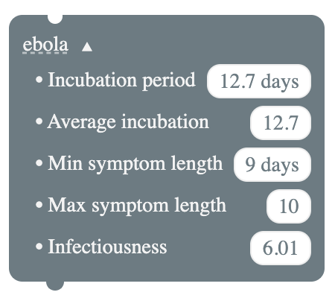
Ebola

Slide 3


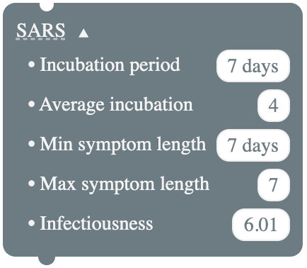
SARS

